Slide 1
NF Collab Update – Proposed Figures
07/12/2023

Slide 2
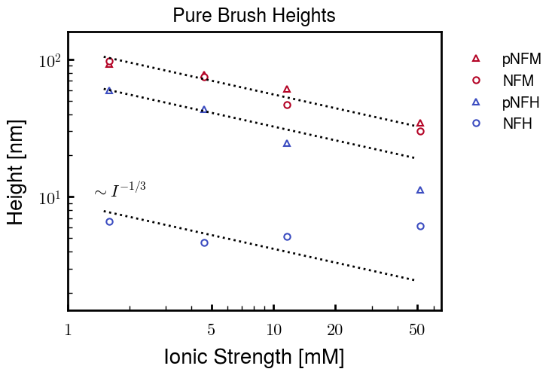
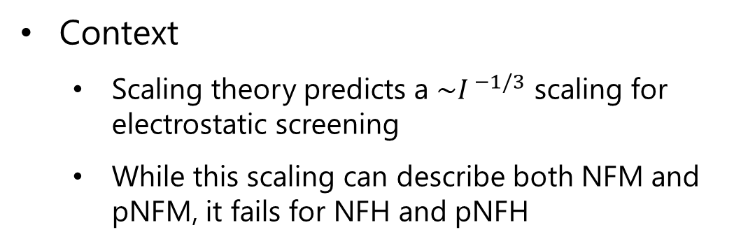
Research Question
How do the chemical identities of NFH and NFM determine their function within NFs?
Context
Scaling theory predicts a ${\sim I}^{ −1/3}$ scaling for electrostatic screening
While this scaling can describe both NFM and pNFM, it fails for NFH and pNFH

Slide 3
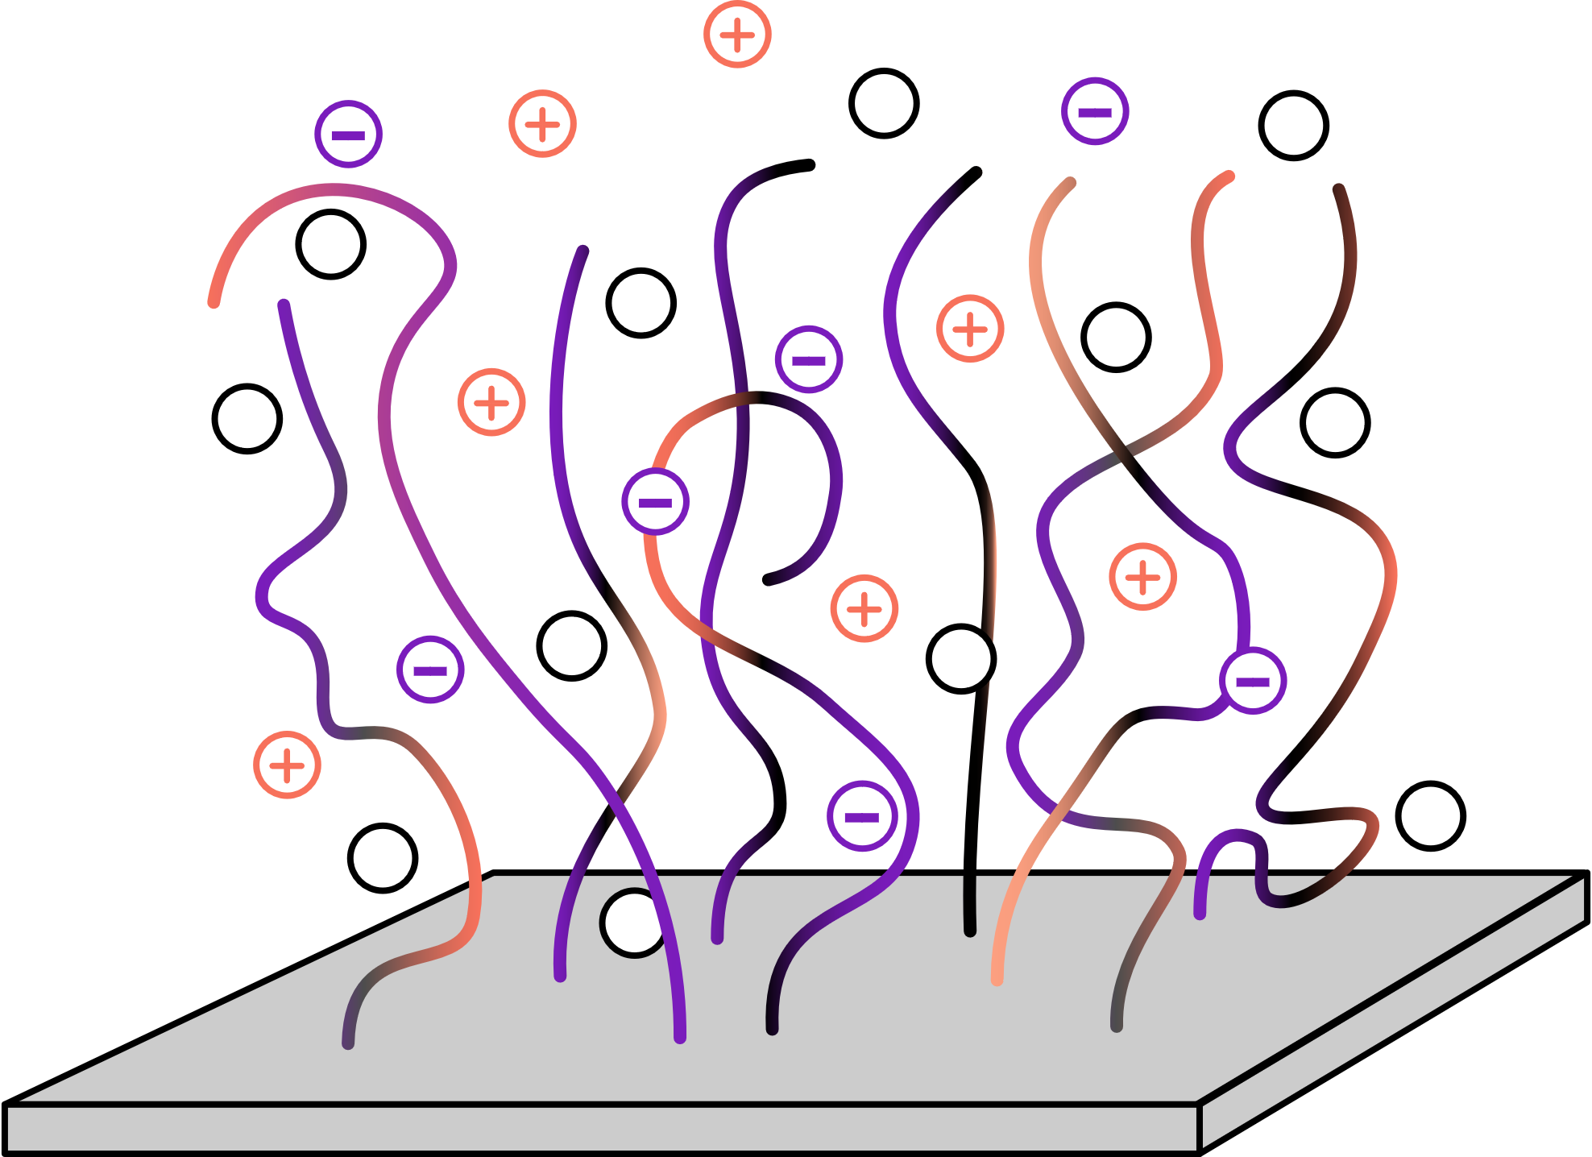
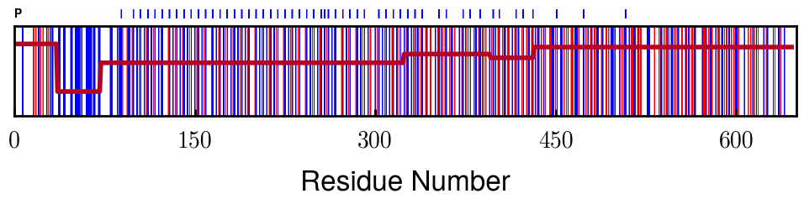
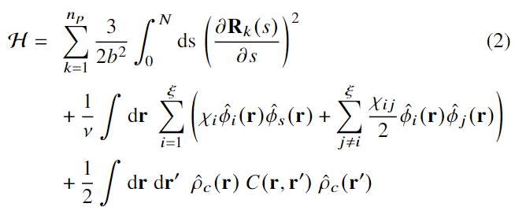
Model
Solvent
System:
Protein amino acid sequence
Solution salt concentration and pH
Protein
Ions
Details:
Charge calculated using bulk pH
Blocks group similar neighbors
Elastic energy
2-body Flory-Huggins
Electrostatics

Slide 4
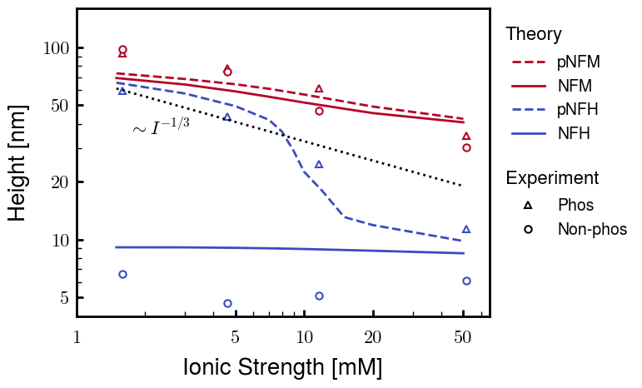
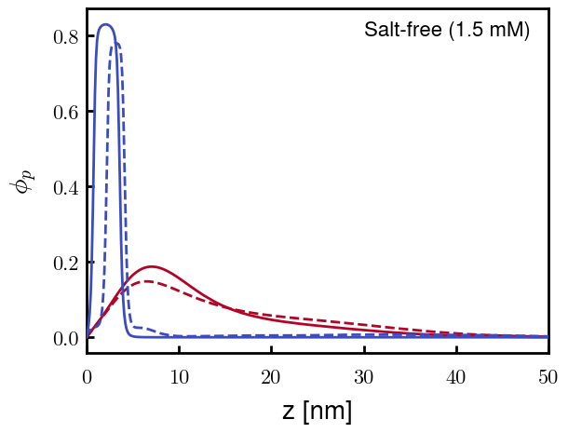
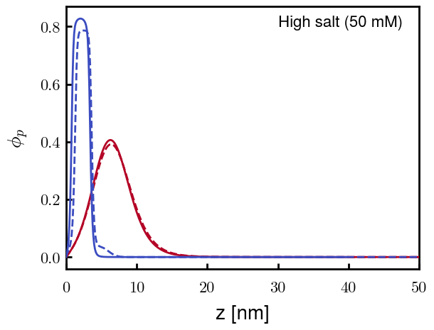
Proposed Figure 1
(a)
(b)
(c)
Caption: (a) Predicted height profiles of phosphorylated and non-phosphorylated NFM and NFH brushes compared with experimentally measured values and scaling theory predictions. (b) Predicted protein density distributions for pNFM, NFM, pNFH, and NFH in the salt-free solution. (c) Predicted protein density distributions in high salt solution.
Discussion:
(p)NFM collapses, but does not fully condense (AG brush-like)
pNFH undergoes non-trivial transition at intermediate ionic strengths (difficult to see in density profiles here)
NFH remains undisturbed in condensed layer (totally screened)

Slide 5
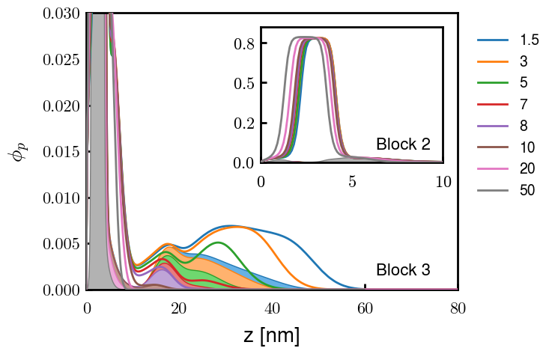
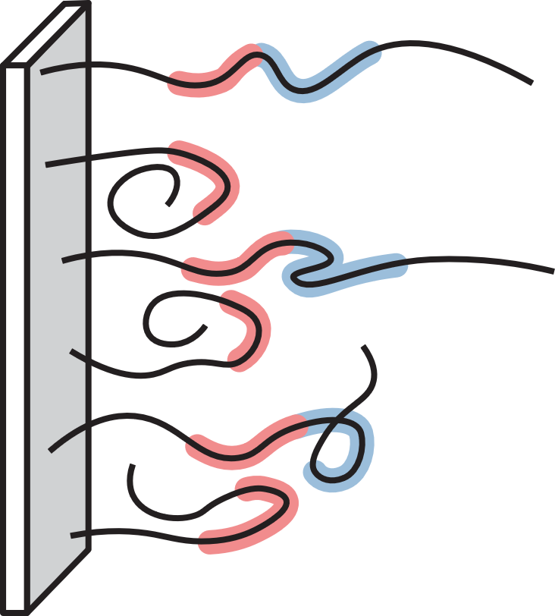
Proposed Figure 2
(a)
(b)
Caption: (a) Protein density profiles for pNFH at selected ionic strengths. Densities corresponding to the second (inset) and third (main) blocks are filled. (b) Schematic of pNFH morphology at low ionic strengths. Block 2 (red) forms the outer region of the condensed layer and a fraction of proteins extend into the dilute layer beginning with block 3 (blue).
Discussion:
Block 2 (heterogeneous negative) and 3 (phosphorylation) determine pNFH morphology
Block 3 density profile reaches 0 at ~15 nm, signifying chains don’t fold back once in dilute layer
Note: Unsure of where to put coarse-grained charge distribution (Slide 3)

Slide 6
Conclusions
Back to the research question: How do the chemical identities of NFH and NFM determine their function within NFs?
Phosphorylation: NFH activates its sensitivity to ionic strength via a conformational change (dilute phase)
Local patterning: NFM does not condense due to its high b value (3.00 nm) compared to NFH (0.50 nm).
Difficult to discuss due to b values being coarse-grained parameters; however, it still describes the local stiffness of each protein (and fitting such tall brushes is not possible without them)

Slide 7
SI Table of Contents

Slide 8
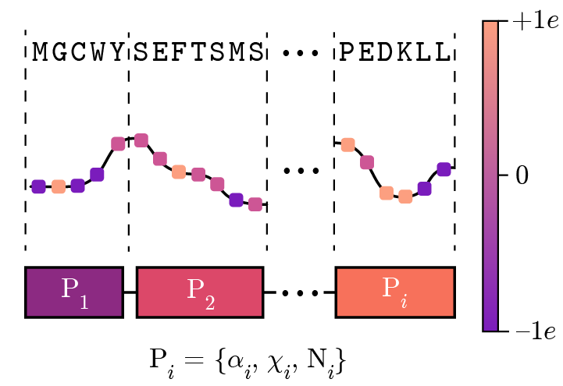
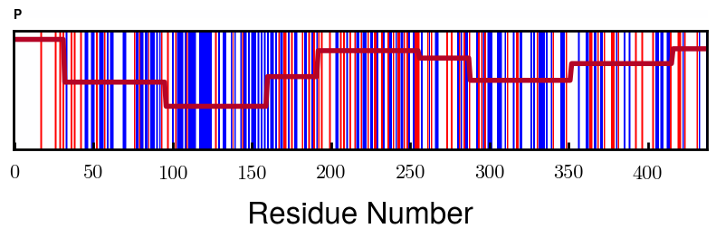
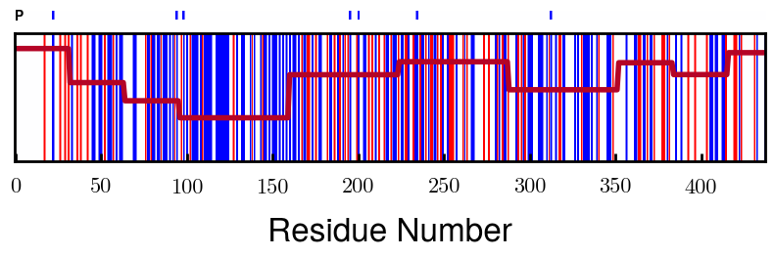
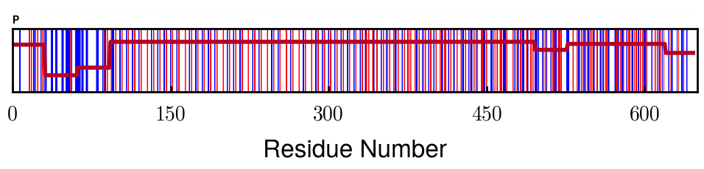
Protein Charge Distribution
Amino acid
Algorithm overview
Charge (at given pH)
Block assignment
NFM
> 0e
= 0e
< 0e
NFH

Slide 9
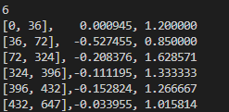
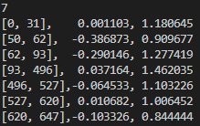
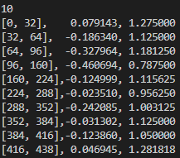
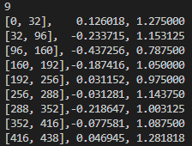
Parameters
pNFH
NFH
pNFM
NFM
Net: -92.27
e/c: -0.143
Net: -32.37
e/c: -0.050
Net: -72.34
e/c: -0.165
Net: -62.84
e/c: -0.143
Chi_max = 3.00
Sigma = 0.025 c/nm2
T = 293 K
(p)NFH: 0.50 nm, 0.20 nm3
(p)NFM: 3.00 nm, 2.00 nm3

Slide 10
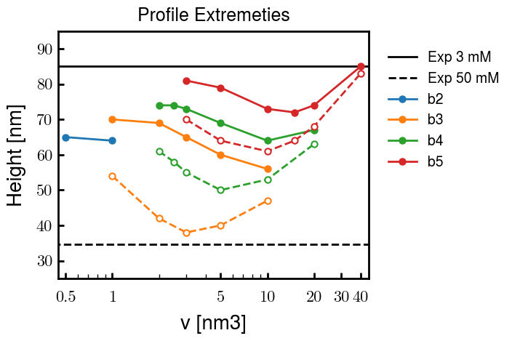
pNFM Fitting (b/v)

Slide 11
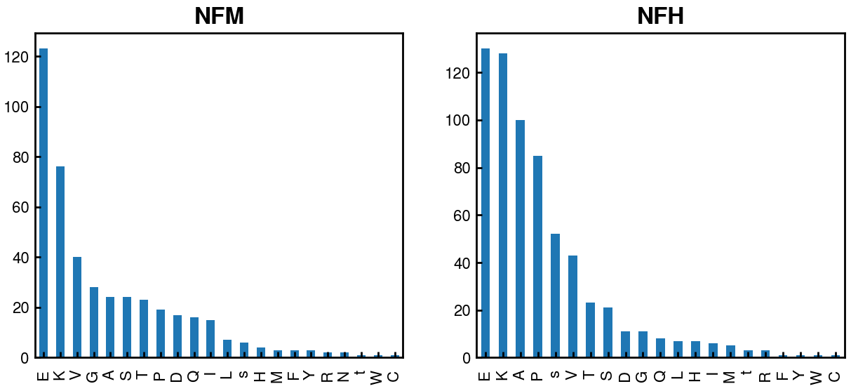
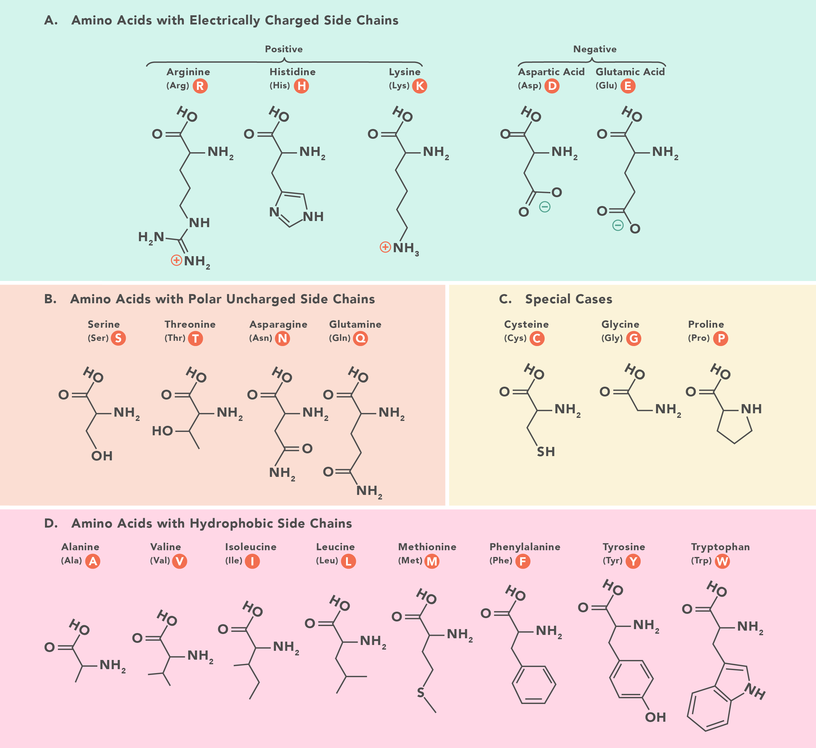


AA
Increasing stiffness
1
2
3
?
5
6
b = 4.00 nm
b = 0.50 nm
With P = 0:
With P = 4:

